Slide 1
Biological Modeling of Neural Networks:
Week 9 – part 1 : Models and data
9.1 What is a good neuron model?
- Models and data
9.2 AdEx model
- Firing patterns and adaptation
9.3 Spike Response Model (SRM)
- Integral formulation
9.4 Generalized Linear Model
- Adding noise to the SRM
9.5 Parameter Estimation
- Quadratic and convex optimization
9.6. Modeling in vitro data
- how long lasts the effect of a spike?
Week 9 – Optimizing Neuron Models
For Coding and Decoding
Wulfram Gerstner
EPFL, Lausanne, Switzerland
Notes:
Lecture 1: move rapidly through the review, then AdEx on the Blackboard.
Quiz of nullclines in middle of lecture (at about 9:35)
Exercise 1 should start at end of lecture

Slide 2
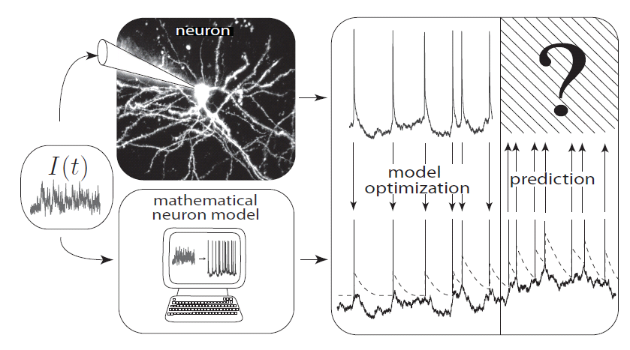
Neuronal Dynamics – 9.1 Neuron Models and Data
What is a good neuron model?
Estimate parameters of models?

Slide 3
Neuronal Dynamics – 9.1 What is a good neuron model?
Predict spike times
Predict subthreshold voltage
Easy to interpret (not a ‘black box’)
Flexible enough to account for a variety of phenomena
Systematic procedure to ‘optimize’ parameters

Slide 4
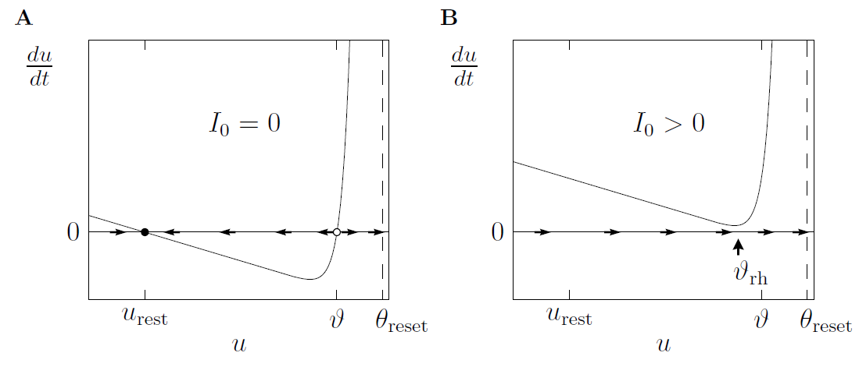
Neuronal Dynamics – Review: Nonlinear Integrate-and-fire
See:
week 1,
lecture 1.5
What is a good choice of f ?

Slide 5
Neuronal Dynamics – Review: Nonlinear Integrate-and-fire
(1)
(2)
What is a good choice of f ?
(i) Extract f from more complex models
(ii) Extract f from data

Slide 6
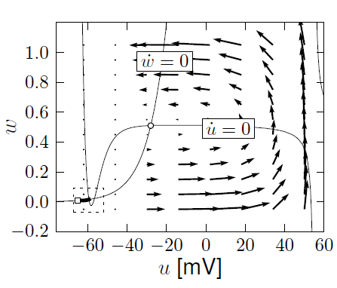
Neuronal Dynamics – Review: Nonlinear Integrate-and-fire
(i) Extract f from more complex models
A. detect spike and reset
resting state
Separation of time scales:
Arrows are nearly horizontal
Spike initiation, from rest
See week 3:
2dim version of
Hodgkin-Huxley
B. Assume w=wrest

Slide 7
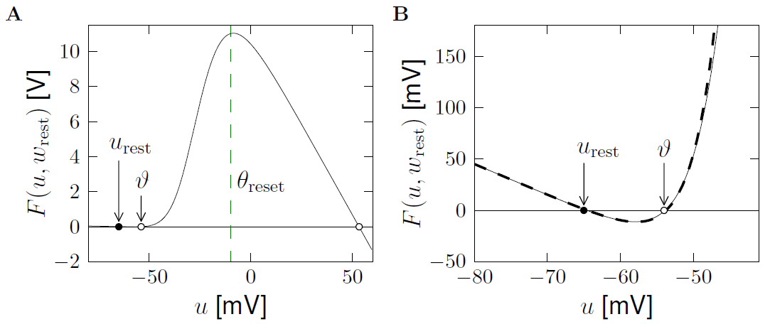
Neuronal Dynamics – Review: Nonlinear Integrate-and-fire
(i) Extract f from more complex models
exponential
linear
See week 4:
2dim version of
Hodgkin-Huxley
Separation of
time scales

Slide 8
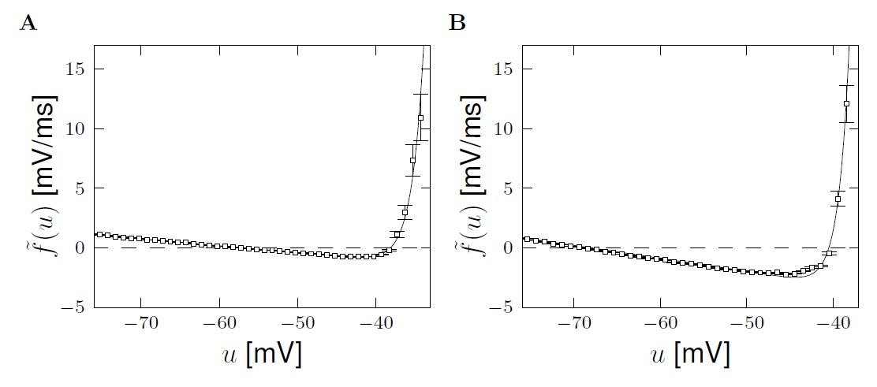
Neuronal Dynamics – Review: Nonlinear Integrate-and-fire
(ii) Extract f from data
Badel et al. (2008)
Exp. Integrate-and-Fire, Fourcaud et al. 2003
Pyramidal neuron
Inhibitory interneuron
exponential
exponential
Badel et al. (2008)
linear
linear

Slide 9
Neuronal Dynamics – Review: Nonlinear Integrate-and-fire
(1)
(2)
Best choice of f : linear + exponential
BUT: Limitations – need to add
Adaptation on slower time scales
Possibility for a diversity of firing patterns
Increased threshold after each spike
Noise

Slide 10
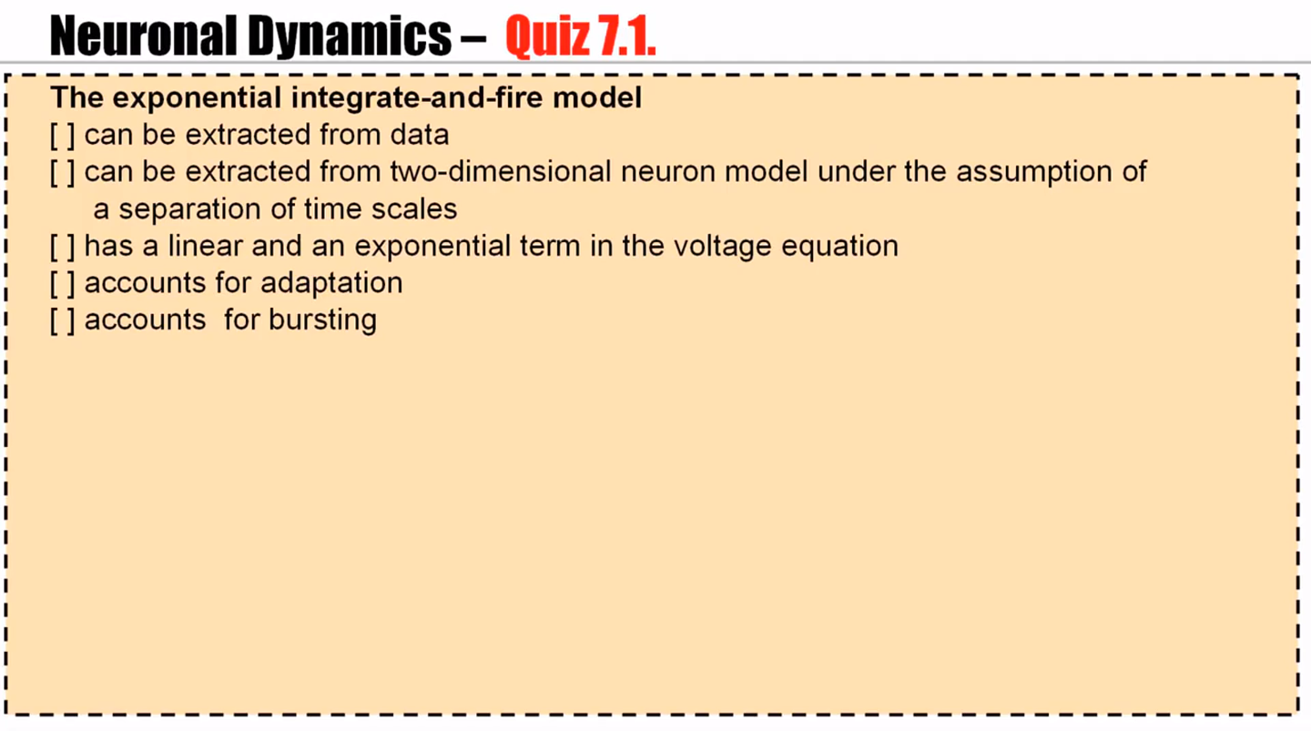

Slide 11
Biological Modeling of Neural Networks:
Week 9 – part 2 : Adaptive Expontential Integrate-and-Fire Model
9.1 What is a good neuron model?
- Models and data
9.2 AdEx model
- Firing patterns and adaptation
9.3 Spike Response Model (SRM)
- Integral formulation
9.4 Generalized Linear Model
- Adding noise to the SRM
9.5 Parameter Estimation
- Quadratic and convex optimization
9.6. Modeling in vitro data
- how long lasts the effect of a spike?
Week 9 – Optimizing Neuron Models
For Coding and Decoding
Wulfram Gerstner
EPFL, Lausanne, Switzerland

Slide 12
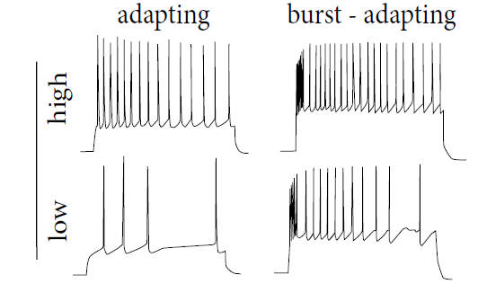
Neuronal Dynamics – 9.2 Adaptation
Step current input – neurons show adaptation
I(t)
Data:
Markram et al.
(2004)
1-dimensional (nonlinear) integrate-and-fire model cannot do this!

Slide 13
Neuronal Dynamics – 9.2 Adaptive Exponential I&F
Add adaptation variables:
Blackboard !
Exponential I&F
+ 1 adaptation var.
= AdEx
SPIKE AND RESET
after each spike
AdEx model,
Brette&Gerstner (2005):
jumps by an amount

Slide 14
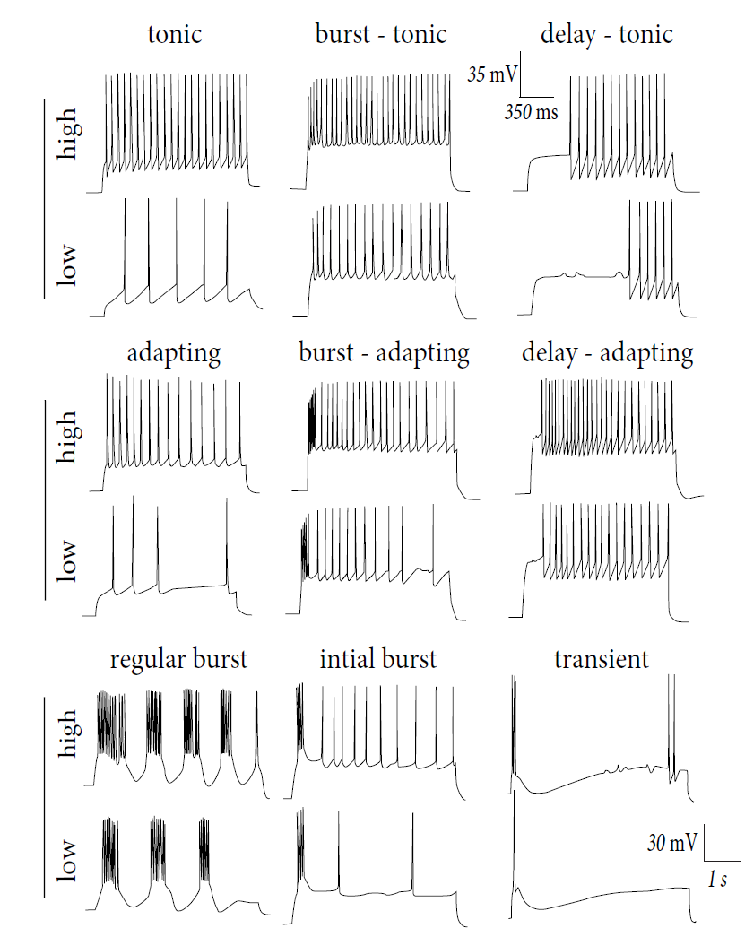
Firing patterns:
Response to
Step currents,
Exper. Data,
Markram et al.
(2004)
I(t)

Slide 15
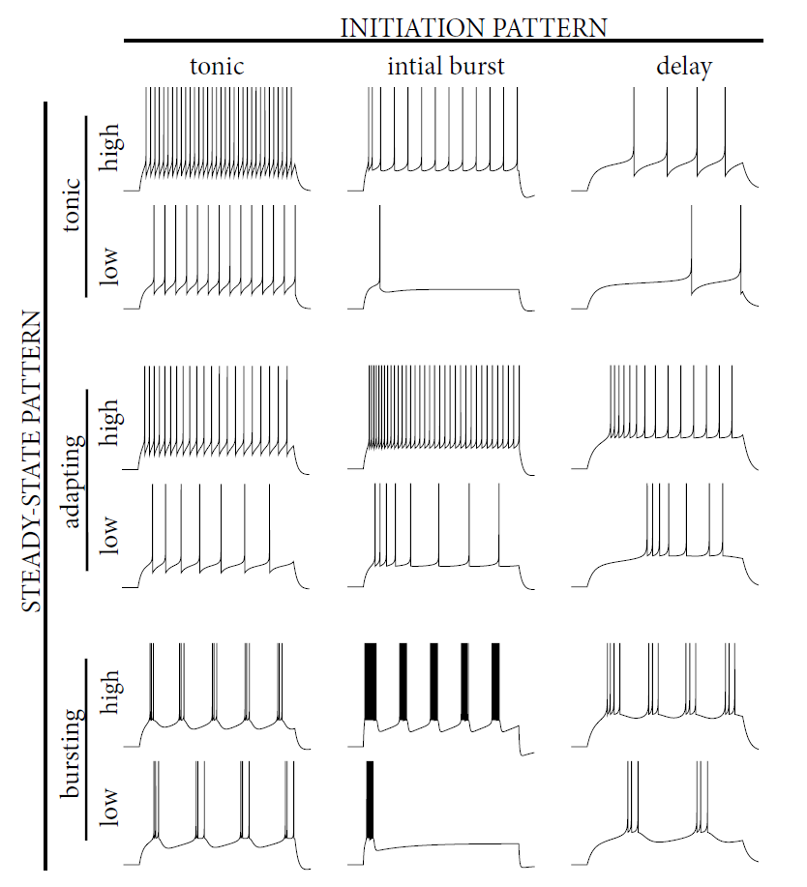
Firing patterns:
Response to
Step currents,
AdEx Model,
Naud&Gerstner
I(t)
Image:
Neuronal Dynamics,
Gerstner et al.
Cambridge (2002)

Slide 16
Neuronal Dynamics – 9.2 Adaptive Exponential I&F
AdEx model
Phase plane analysis!
Can we understand the different firing patterns?

Slide 17
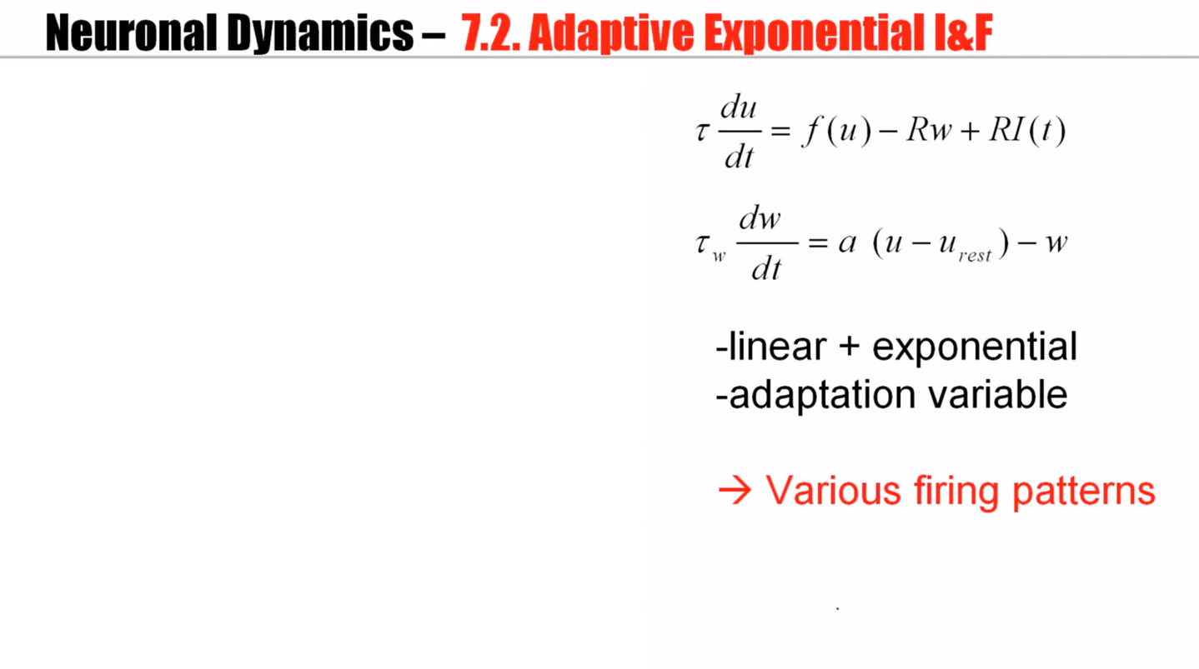
Notes:
Now, one question is whether we can sit in front of the computer and try to optimize parameters by hand or whether we can predict the type of behavior we are expected to get just looking at our choice of parameters. Phase plane analysis will help for this.

Slide 18
Neuronal Dynamics – Quiz 9.1. Nullclines of AdEx
A - What is the qualitative
shape of the w-nullcline?
[ ] constant
[ ] linear, slope a
[ ] linear, slope 1
[ ] linear + quadratic
[ ] linear + exponential
B - What is the qualitative
shape of the u-nullcline?
[ ] linear, slope 1
[ ] linear, slope 1/R
[ ] linear + quadratic
[ ] linear w. slope 1/R+ exponential
1 minute
Restart at 9:38

Slide 19
Biological Modeling of Neural Networks:
Week 9 – part 2b : Firing Patterns
9.1 What is a good neuron model?
- Models and data
9.2 AdEx model
- Firing patterns and adaptation
9.3 Spike Response Model (SRM)
- Integral formulation
9.4 Generalized Linear Model
- Adding noise to the SRM
9.5 Parameter Estimation
- Quadratic and convex optimization
9.6. Modeling in vitro data
- how long lasts the effect of a spike?
Week 9 – Optimizing Neuron Models
For Coding and Decoding
Wulfram Gerstner
EPFL, Lausanne, Switzerland

Slide 20
after each spike
AdEx model
u is reset to ur
after each spike
w jumps by an amount b
parameter a – slope of w-nullcline
Can we understand the different firing patterns?

Slide 21
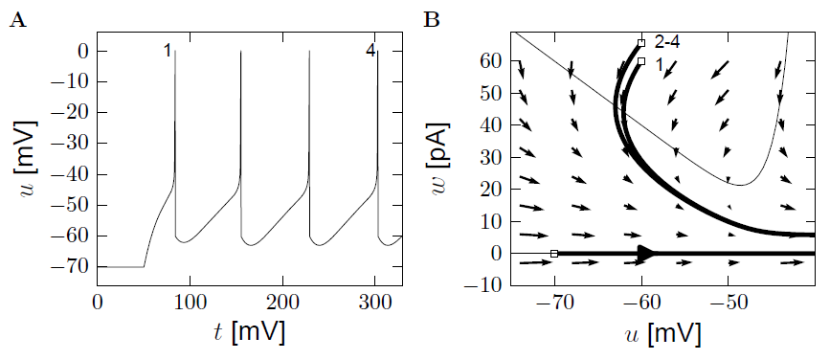
AdEx model – phase plane analysis: large b
a=0
u-nullcline
b
u is reset to ur

Slide 22
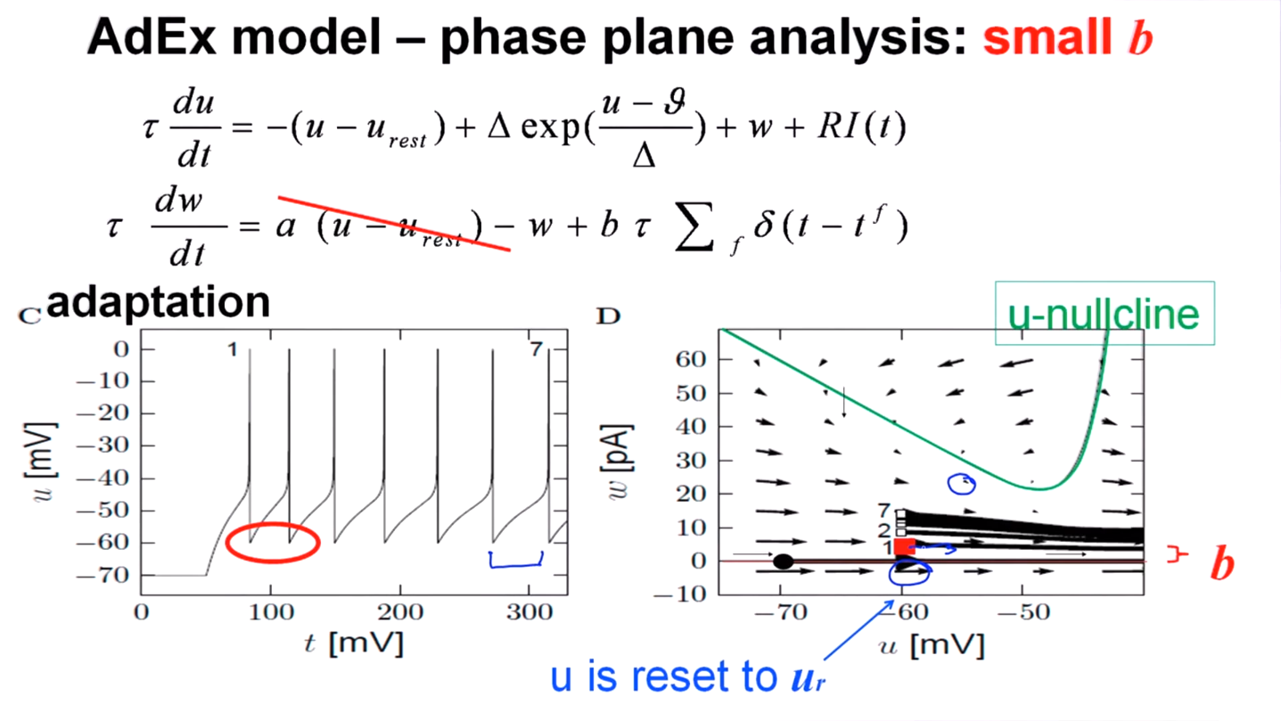

Slide 23
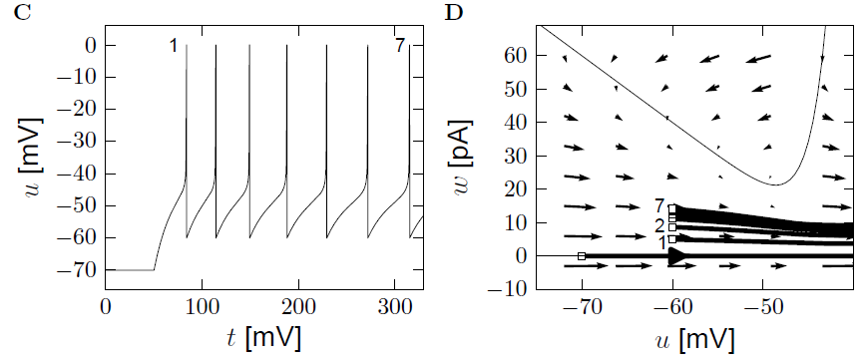
AdEx model – phase plane analysis: small b
adaptation
u-nullcline
b
u is reset to ur

Slide 24
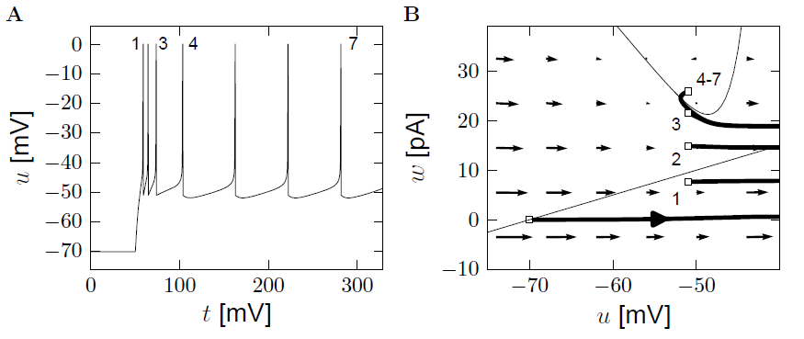
AdEx model – phase plane analysis: a>0
u-nullcline
b
u is reset to ur

Slide 25
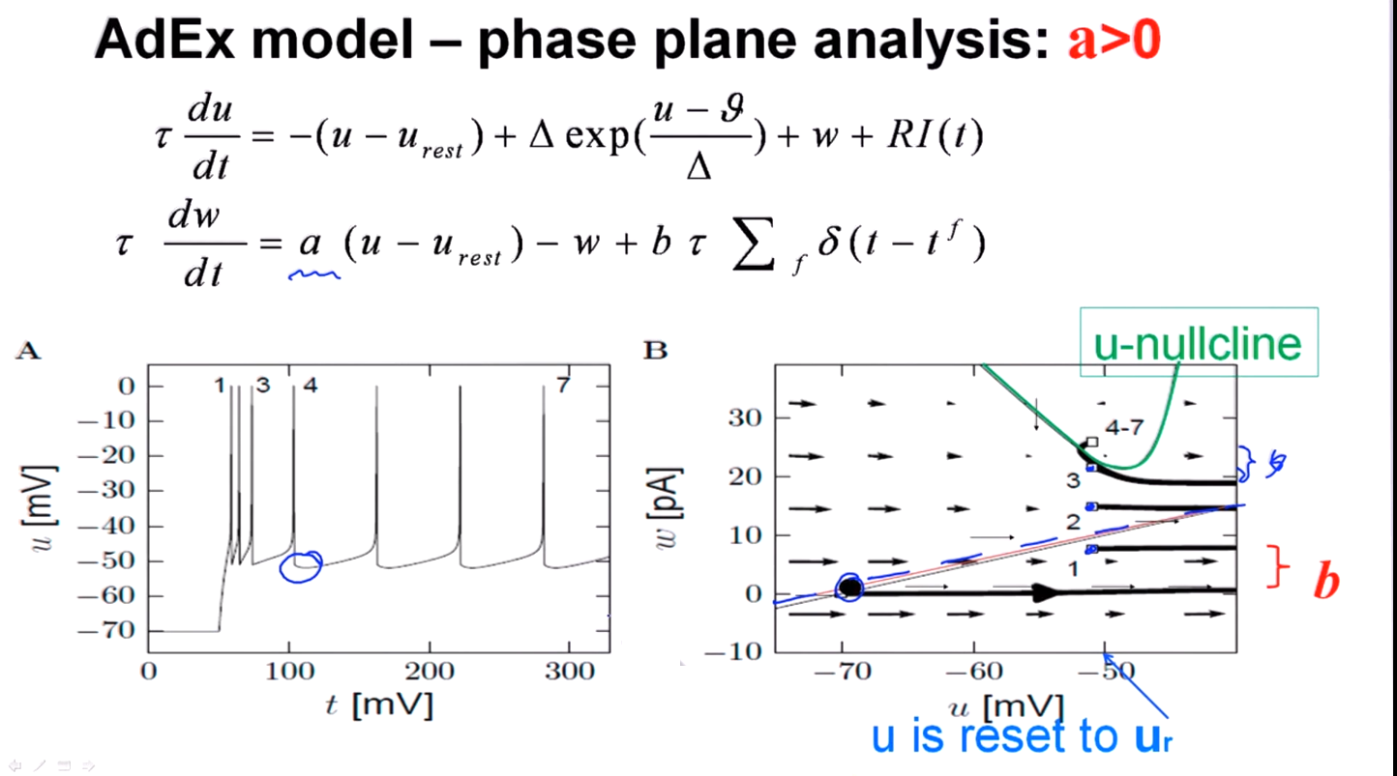
Notes:
It's only after spike number four that we see this dip in the voltage.

Slide 26
Neuronal Dynamics – 9.2 AdEx model and firing patterns
after each spike
u is reset to ur
after each spike
w jumps by an amount b
parameter a – slope of w nullcline
Firing patterns arise from different parameters!
See Naud et al. (2008), see also Izikhevich (2003)

Slide 27
Neuronal Dynamics – Review: Nonlinear Integrate-and-fire
(1)
(2)
Best choice of f : linear + exponential
BUT: Limitations – need to add
Adaptation on slower time scales
Possibility for a diversity of firing patterns
Increased threshold after each spike
Noise

Slide 28
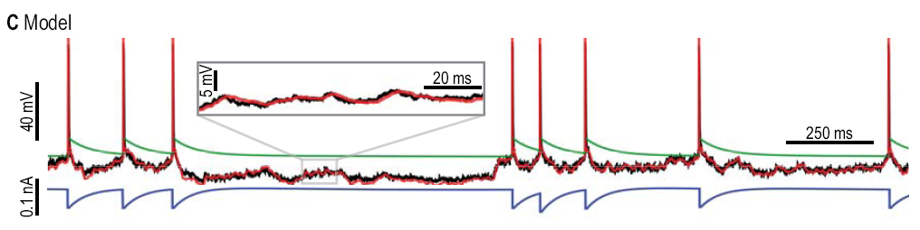
Neuronal Dynamics – 9.2 AdEx with dynamic threshold
Add dynamic threshold:
Threshold increases after each spike

Slide 29
Neuronal Dynamics – 9.2 Generalized Integrate-and-fire
add
Adaptation variables
Possibility for firing patterns
Dynamic threshold
Noise

Slide 30
Quiz 9.2: AdEx model – phase plane analysis
What firing pattern do you expect?
(i) Adapting
(ii) Bursting
(iii) Initial burst
(iv)Non-adapting
u-nullcline
b
u is reset to ur

Slide 31
Biological Modeling of Neural Networks:
Week 9 – part 3: Spike Response Model (SRM)
9.1 What is a good neuron model?
- Models and data
9.2 AdEx model
- Firing patterns and adaptation
9.3 Spike Response Model (SRM)
- Integral formulation
9.4 Generalized Linear Model
- Adding noise to the SRM
9.5 Parameter Estimation
- Quadratic and convex optimization
9.6. Modeling in vitro data
- how long lasts the effect of a spike?
Week 9 – Optimizing Neuron Models
For Coding and Decoding
Wulfram Gerstner
EPFL, Lausanne, Switzerland

Slide 32
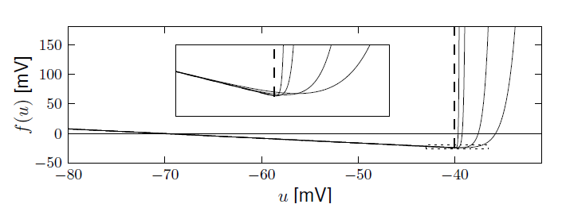
Exponential versus Leaky Integrate-and-Fire
Badel et al (2008)
Leaky Integrate-and-Fire
Reset if u=
Notes:
The exponential term for very sharp delta can be replaced by just a sharp threshold.

Slide 33
Neuronal Dynamics – 9.3 Adaptive leaky integrate-and-fire
after each spike
SPIKE AND RESET
jumps by an amount
Dynamic threshold
Notes:
It's just the adaptive exponential integrate and fire model, except that the non-linear term here has disappeared, and, instead, we've work with a sharper threshold. The threshold itself can be time dependent, as before.

Slide 34
Neuronal Dynamics – 9.3 Adaptive leaky I&F and SRM
Adaptive
leaky I&F
Linear equation → can be integrated!
Spike Response Model (SRM)
Gerstner et al. (1996)
Notes:
Eta is an adaptation kernel, and kernel kappa describes the response to spike arrival.

Slide 35
Neuronal Dynamics – 9.3 Spike Response Model (SRM)
Gerstner et al.,
1993, 1996
i
Input
I(t)
Spike emission
u(t)
Arbitrary
Linear filters
potential
threshold
Notes:
And there are three of these kernels, a filter kappa for the external input, a filter eta that describes refraction as an adaptation, and the filter theta that accounts for the dynamic threshold, an increased threshold immediately after a spike.

Slide 36
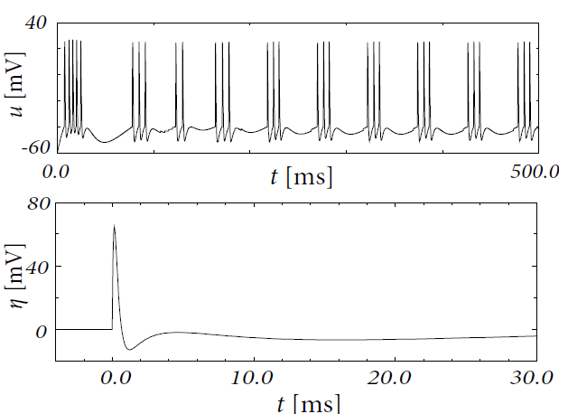
Neuronal Dynamics – 9.3 Bursting in the SRM
SRM with appropriate
leads to bursting

Slide 37
Neuronal Dynamics – 9.3 Spike Response Model (SRM)
Gerstner et al.,
1993, 1996
Input
I(t)
S(t)
+
potential
threshold
firing if

Slide 38
Neuronal Dynamics – 9.3 Spike Response Model (SRM)
potential
+
threshold
Linear filters for
- input
- threshold
- refractoriness

Slide 39
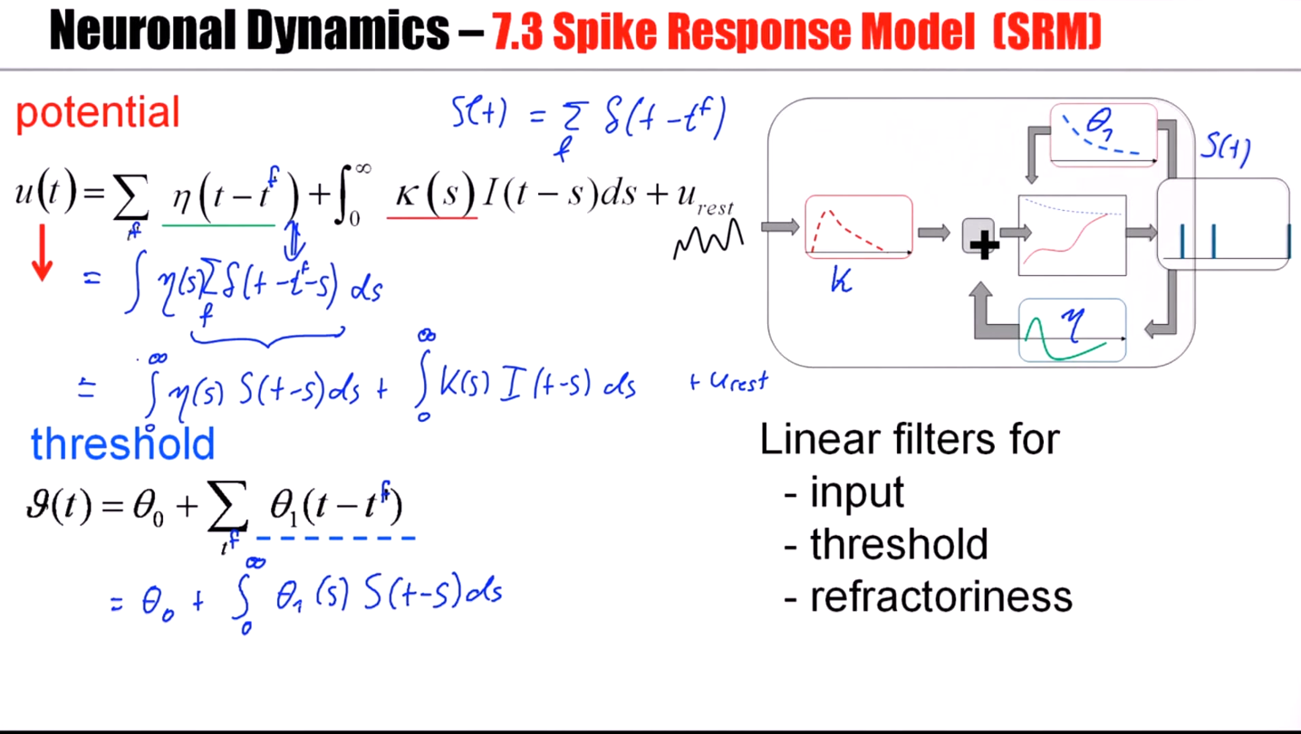
Notes:
The filter kappa here, the filter eta here, the filter theta 1 here - all are treated in a parallel fashion.
These filters are used in convolutions of the input with the filter kappa, convolutions of the output spike train with the filter eta and with the filter theta 1.

Slide 40
Exercise 1: from adaptive IF to SRM
Next lecture
at 9:57/10:15
Integrate the above system of two differential equations so as to rewrite the equations as
potential
A – what is ?
(i)
(ii)
B – what is ?
(iii)
(iv) Combi of
(i) + (iii)
Notes:
Exercise should start before the break.

Slide 41
Biological Modeling of Neural Networks:
Week 9 – part 4: Generalized Linear Model (GLM)
9.1 What is a good neuron model?
- Models and data
9.2 AdEx model
- Firing patterns and adaptation
9.3 Spike Response Model (SRM)
- Integral formulation
9.4 Generalized Linear Model
- Adding noise to the SRM
9.5 Parameter Estimation
- Quadratic and convex optimization
9.6. Modeling in vitro data
- how long lasts the effect of a spike?
Week 9 – Optimizing Neuron Models
For Coding and Decoding
Wulfram Gerstner
EPFL, Lausanne, Switzerland

Slide 42

Spike Response Model (SRM)
Generalized Linear Model GLM
Gerstner et al.,
1992,2000
Truccolo et al., 2005
Pillow et al. 2008
I(t)
S(t)
+
potential
threshold
firing intensity
Notes:
We say that firing is a stochastic process with a firing intensity that depends on the momentary distance between the membrane potential.

Slide 43
Neuronal Dynamics – review from week 8: Escape noise
escape process
escape rate
u(t)
t
escape rate
Example: leaky integrate-and-fire model
u

Slide 44
Neuronal Dynamics – review from week 8: Escape noise
escape process
Survivor function
u(t)
t
escape rate
Interval distribution
escape
rate
Good choice
Survivor function
u

Slide 45
Neuronal Dynamics – 9.4 Likelihood of a spike train in GLMs
Blackboard
Measured spike train with spike times
Likelihood L that this spike train
could have been generated by model?
Notes:
A spike response model with escape noise, also called generalized linear model.

Slide 46
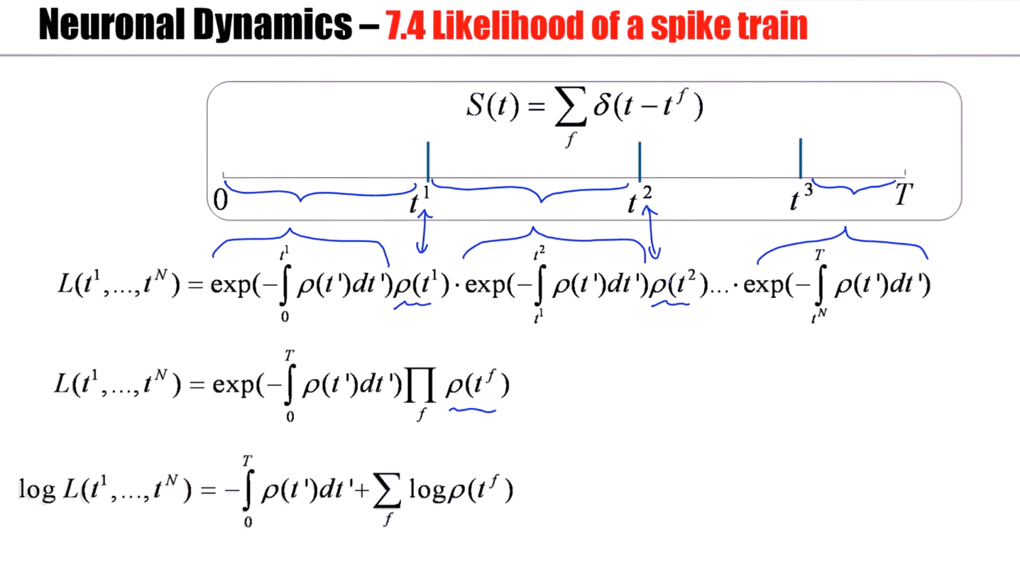

Slide 47
Neuronal Dynamics – 9.4 Likelihood of a spike train

Slide 48
Neuronal Dynamics – 9.4 SRM with escape noise = GLM
+
linear filters
escape rate
→likelihood of observed
spike train
parameter optimization
of neuron model
Notes:
If you take a spike response model with its three linear filters, and if we add escape noise, then we can write down the likelihood of an observed spike train, the likelihood that such a spike train could have been generated by the model. Thus, we have a generative model for spike trains.

Slide 49
Exerc. 2.1: Non-leaky IF with escape rates
nonleaky
Integrate for constant input (repetitive firing)
Next lecture
at 10:38
Calculate
- potential
- hazard
- survivor function
- interval distrib.
Notes:
12 minutes for the students, to do the exercise

Slide 50
Biological Modeling of Neural Networks:
Week 9 – part 5: Parameter Estimation
9.1 What is a good neuron model?
- Models and data
9.2 AdEx model
- Firing patterns and adaptation
9.3 Spike Response Model (SRM)
- Integral formulation
9.4 Generalized Linear Model
- Adding noise to the SRM
9.5 Parameter Estimation
- Quadratic and convex optimization
9.6. Modeling in vitro data
- how long lasts the effect of a spike?
Week 9 – Optimizing Neuron Models
For Coding and Decoding
Wulfram Gerstner
EPFL, Lausanne, Switzerland

Slide 51
Neuronal Dynamics – 9.5 Parameter estimation: voltage
Spike Response Model (SRM)
Generalized Lin. Model (GLM)
S(t)
I(t)
+
Subthreshold
potential
known spike train
known input
Linear filters/linear in parameters

Slide 52
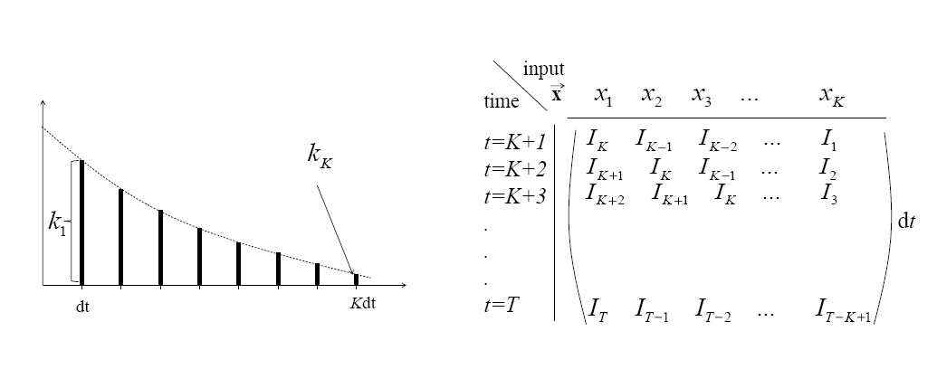
Neuronal Dynamics – 9.5 Parameter estimation: voltage
Linear in parameters = linear fit = quadratic problem
comparison model-data
Blackboard: Riemann-sum

Slide 53
Neuronal Dynamics – 9.5 Parameter estimation: voltage
Linear in parameters = linear fit
I
Blackboard: Error function

Slide 54
Neuronal Dynamics – 9.5 Parameter estimation: voltage
Linear in parameters = linear fit = quadratic optimization
Model
Data
I

Slide 55
Neuronal Dynamics – 9.5 Parameter estimation: voltage
Vector notation

Slide 56
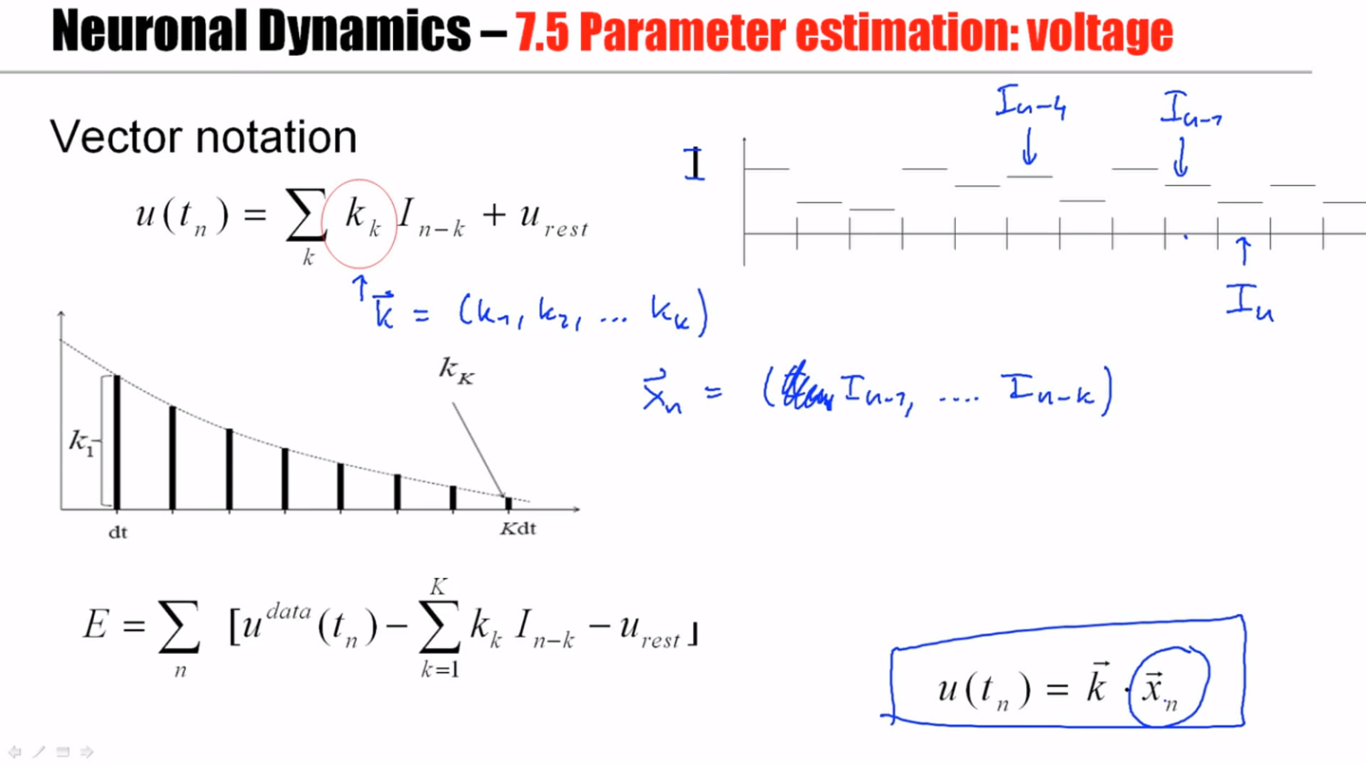

Slide 57
Neuronal Dynamics – 9.5 Parameter estimation: voltage
Linear in parameters = linear fit = quadratic problem

Slide 58
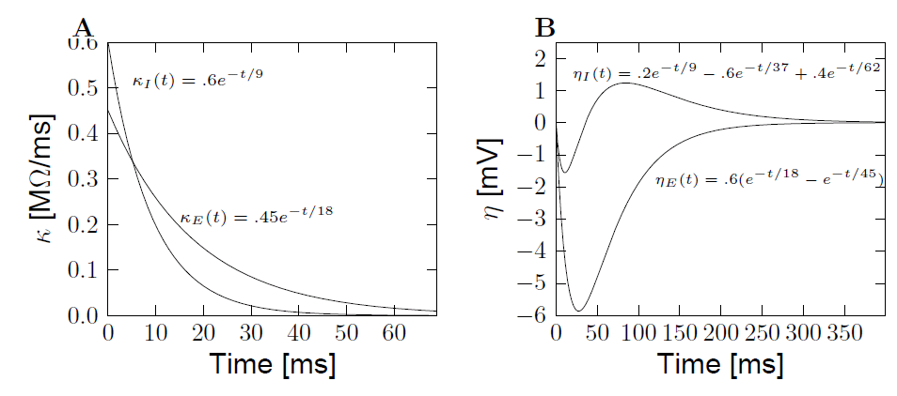
Neuronal Dynamics – 9.5 Extracted parameters: voltage
Subthreshold
potential
known input
known spike train
inhibitory
interneuron
pyramidal
pyramidal
Mensi et al., 2012

Slide 59
Neuronal Dynamics – What is a good neuron model?
Predict spike times
Predict subthreshold voltage
Easy to interpret (not a ‘black box’)
Flexible
Systematic: ‘optimize’ parameters
Notes:
But so far, our approach has been limited to the sub threshold membrane potential. Ideally, from a neuron model, we would also like to predict spikes.

Slide 60
Exercise 3 NOW: optimize 1 free parameter
Model
Data
Optimize parameter R, so as to have a minimal error
I

Slide 61
Biological Modeling of Neural Networks:
Week 9 – part 5b: Quadratic and Convex Optimization
9.1 What is a good neuron model?
- Models and data
9.2 AdEx model
- Firing patterns and adaptation
9.3 Spike Response Model (SRM)
- Integral formulation
9.4 Generalized Linear Model
- Adding noise to the SRM
9.5 Parameter Estimation
- Quadratic and convex optimization
9.6. Modeling in vitro data
- how long lasts the effect of a spike?
Week 9 – Optimizing Neuron Models
For Coding and Decoding
Wulfram Gerstner
EPFL, Lausanne, Switzerland

Slide 62
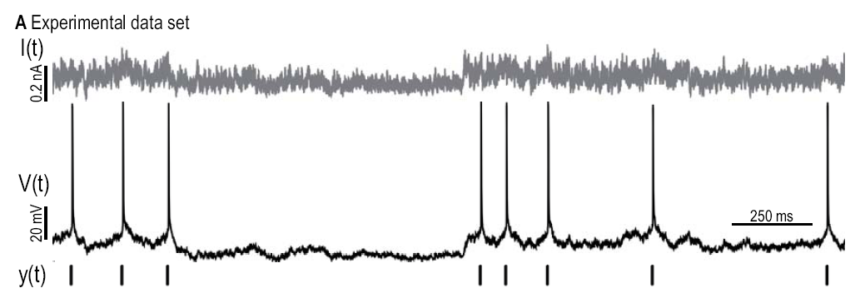
Fitting models to data: so far ‘subthreshold’
Dyn. threshold
Adaptation current

Slide 63
Neuronal Dynamics – 9.5 Threshold: Predicting spike times
Jolivet&Gerstner, 2005
Paninski et al., 2004
Pillow et al. 2008
I(t)
S(t)
+
potential
threshold
firing intensity

Slide 64
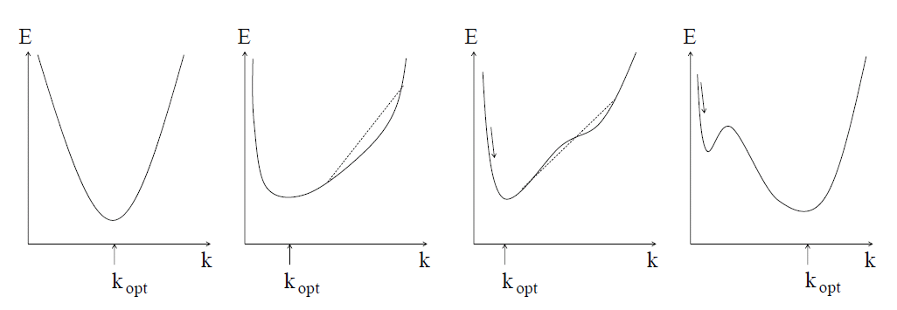
Neuronal Dynamics – 9.5 Generalized Linear Model (GLM)
potential
threshold
firing intensity

Slide 65
Neuronal Dynamics – 9.5 GLM: concave error function
potential
threshold
firing intensity
Paninski, 2004

Slide 66
Neuronal Dynamics – 9.5 quadratic and convex/concave optimization
Voltage/subthreshold
- linear in parameters
→ quadratic error function
Spike times
- nonlinear, but GLM
→ convex error function

Slide 67
Quiz NOW :
What are the units of ?
Voltage?
Resistance?
Resistance/s?
Current?
I(t)
S(t)
+
potential
threshold
firing intensity

Slide 68
Quiz NOW:
What are the units of ?
Voltage?
Resistance?
Resistance/s?
Current?
I(t)
S(t)
+
potential
threshold
firing intensity

Slide 69
Biological Modeling of Neural Networks:
Week 9 – part 6: Modeling in vitro data
9.1 What is a good neuron model?
- Models and data
9.2 AdEx model
- Firing patterns and adaptation
9.3 Spike Response Model (SRM)
- Integral formulation
9.4 Generalized Linear Model
- Adding noise to the SRM
9.5 Parameter Estimation
- Quadratic and convex optimization
9.6. Modeling in vitro data
- how long lasts the effect of a spike?
9.7. Helping Humans
Week 9 – Optimizing Neuron Models
For Coding and Decoding
Wulfram Gerstner
EPFL, Lausanne, Switzerland

Slide 70
Neuronal Dynamics – 9.6 Models and Data
comparison model-data
Predict
Subthreshold voltage
Spike times

Slide 71
Neuronal Dynamics – 9.6 GLM/SRM with escape noise
Jolivet&Gerstner, 2005
Paninski et al., 2004
Pillow et al. 2008
I(t)
S(t)
+
potential
threshold
firing intensity

Slide 72
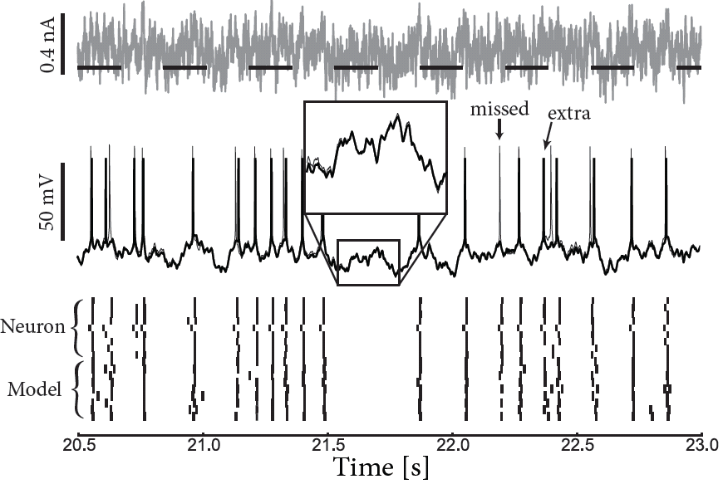
Neuronal Dynamics – 9.6 GLM/SRM predict subthreshold voltage
neuron
Image:Mensi et al.
model

Slide 73
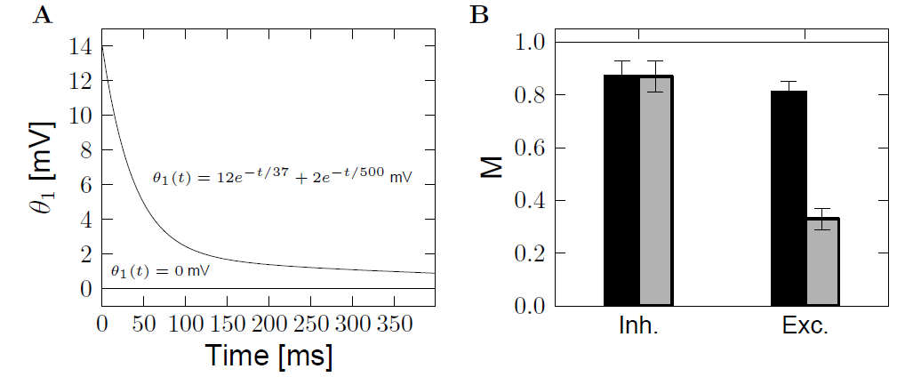
Neuronal Dynamics – 9.6 GLM/SRM predict spike times
Role of moving threshold
No moving threshold
With moving threshold
Mensi et al., 2012

Slide 74
Change in model formulation:
‘soft-threshold
adaptive IF model’
What are the units of …. ?
exponential
I(t)
S(t)
+
adaptation
current
potential
threshold
firing intensity

Slide 75
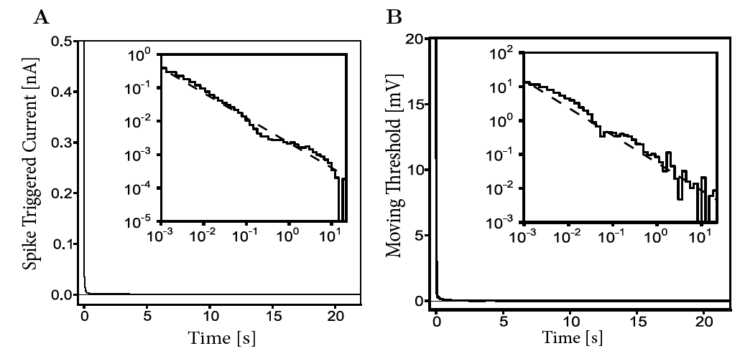
Neuronal Dynamics – 9.6 How long does the effect of a spike last?
Time scale of filters?
→ Power law
A single spike has a measurable effect
more than 10 seconds later!
Pozzorini et al. 2013
Notes:
The spike the rate in itself is just one millisecond or two or three. But a single spike has an effect still 10 seconds later.
So these adaptation effects, they're not just 50 milliseconds or 200 milliseconds. They extend over several seconds. They are strongest for short times, for 10 milliseconds, for 50 milliseconds. But you still have a measurable effect 10 seconds later from a single spike.

Slide 76
Neuronal Dynamics – 9.6 Models and Data
-Predict spike times
-Predict subthreshold voltage
-Easy to interpret (not a ‘black box’)
-Variety of phenomena
-Systematic: ‘optimize’ parameters
BUT so far limited to in vitro
Notes:
Now, all this is modeling off in vitro data: An experimentalist injects a current into a neuron and measures the response.

Slide 77
Biological Modeling of Neural Networks:
Week 9 – part 7: Helping Humans
9.1 What is a good neuron model?
- Models and data
9.2 AdEx model
- Firing patterns and adaptation
9.3 Spike Response Model (SRM)
- Integral formulation
9.4 Generalized Linear Model
- Adding noise to the SRM
9.5 Parameter Estimation
- Quadratic and convex optimization
9.6. Modeling in vitro data
- how long lasts the effect of a spike?
9.7. Helping Humans
Week 9 – Optimizing Neuron Models
For Coding and Decoding
Wulfram Gerstner
EPFL, Lausanne, Switzerland

Slide 78
Neuronal Dynamics – Review: Models and Data
-Predict spike times
-Predict subthreshold voltage
-Easy to interpret (not a ‘black box’)
-Variety of phenomena
-Systematic: ‘optimize’ parameters
BUT so far limited to in vitro
Notes:
Now for in vivo data, in most cases, recordings are done extracellularly, which means that you don't have access to subthreshold voltage.

Slide 79
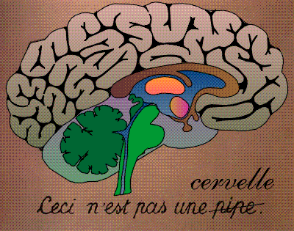
Neuronal Dynamics – 7.7 Systems neuroscience, in vivo
Now: extracellular
recordings
visual
cortex
Predict spike times, given stimulus
Predict subthreshold voltage
Easy to interpret (not a ‘black box’)
Flexible enough to account for a variety of phenomena
Systematic procedure to ‘optimize’ parameters
Model of ‘Encoding’

Slide 80
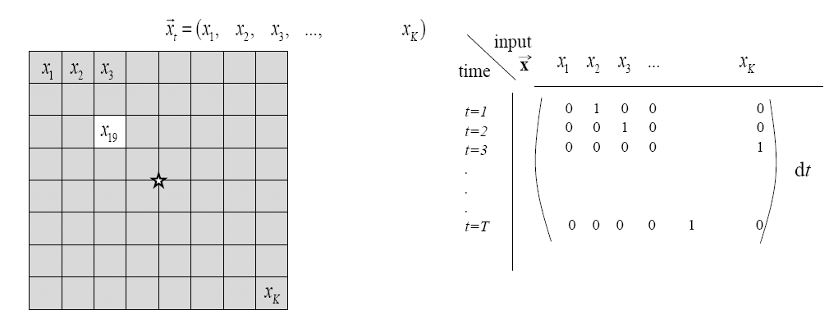
Neuronal Dynamics – 7.7 Estimation of receptive fields
Estimation of spatial (and temporal) receptive fields
LNP
firing intensity

Slide 81
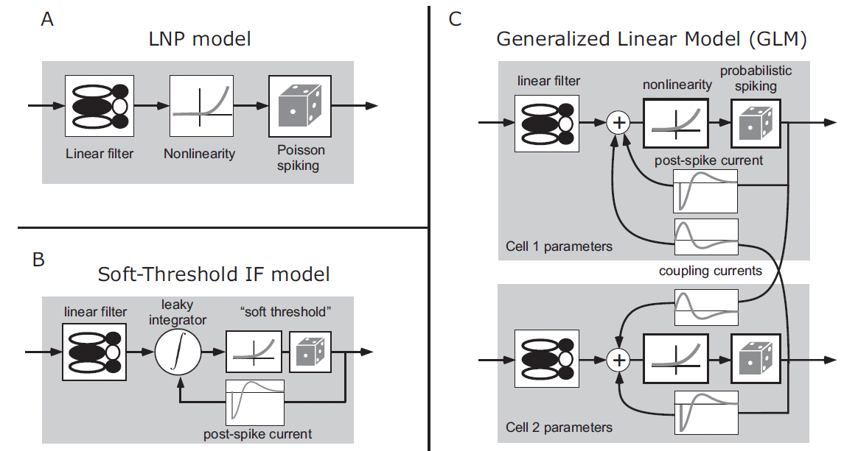
Neuronal Dynamics – 7.7 Estimation of Receptive Fields
visual
stimulus
LNP =
Linear-Nonlinear-Poisson
Special case of
GLM=
Generalized Linear Model

Slide 82
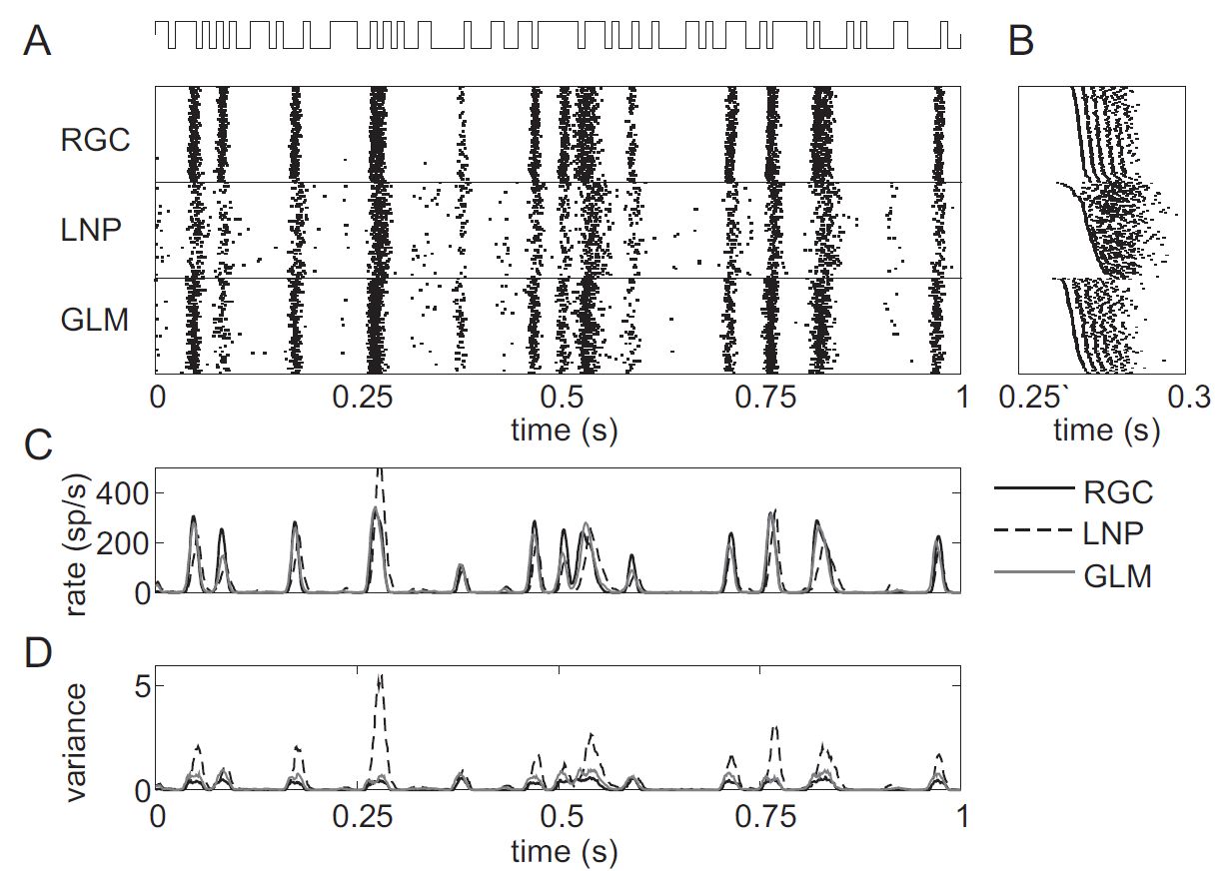
GLM for prediction of retinal ganglion ON cell activity
Pillow et al. 2008

Slide 83
Neuronal Dynamics – 7.7 GLM with lateral coupling

Slide 84
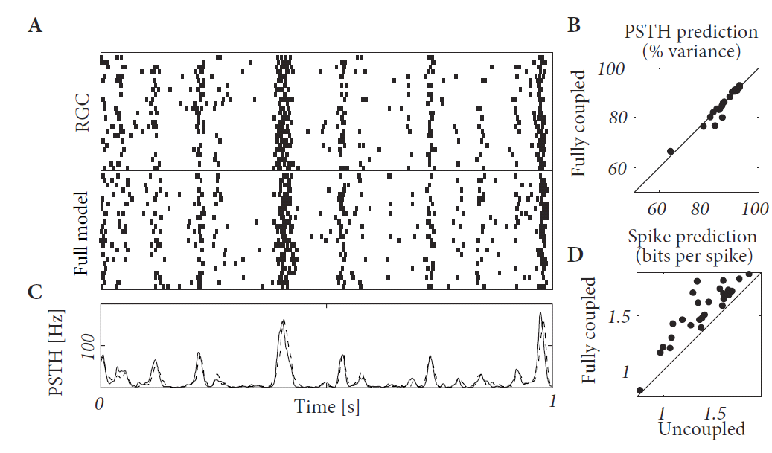
One cell in a Network of Ganglion cells
Pillow et al. 2008

Slide 85
Neuronal Dynamics – 7.7 Model of ENCODING
visual
cortex
Predict spike times, given stimulus
Predict subthreshold voltage
Easy to interpret (not a ‘black box’)
Flexible enough to account for a variety of phenomena
Systematic procedure to ‘optimize’ parameters
Model of ‘Encoding’

Slide 86
Neuronal Dynamics – 7.7 ENCODING and Decoding
Model of ‘Encoding’
Generalized Linear Model (GLM)
- flexible model
- systematic optimization
of parameters
Model of ‘Decoding’
The same GLM works!
- flexible model
- systematic optimization
of parameters

Slide 87
Neuronal Dynamics – 7.7 Model of DECODING
Predict stimulus!
visual
cortex
Model of ‘Decoding’:
predict stimulus, given spike times

Slide 88
Neuronal Dynamics – 7.7 Helping Humans
Application: Neuroprosthetics
frontal
cortex
Many groups
world wide
work on this
problem!
motor
cortex
Model of
‘Decoding’
Predict intended arm movement,
given Spike Times

Slide 89
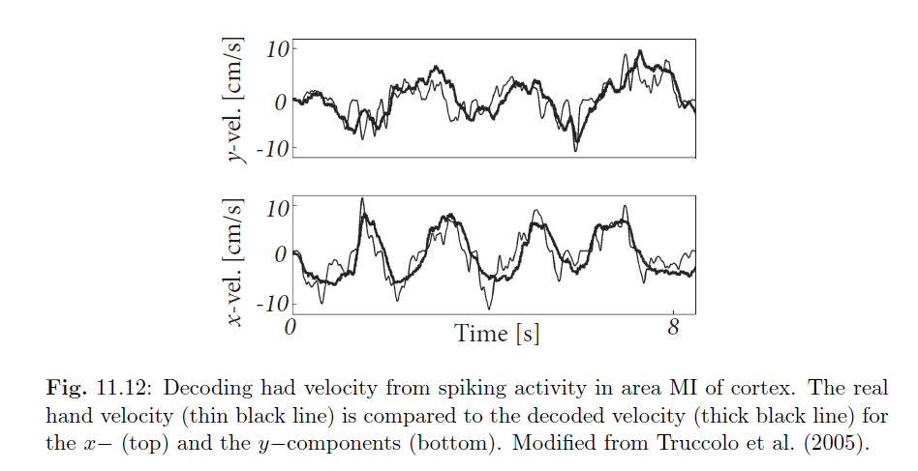
Neuronal Dynamics – 7.7 Basic neuroprosthetics
Application: Neuroprosthetics
Decode the intended arm movement
Hand velocity

Slide 90
Neuronal Dynamics – 7.7 Why mathematical models?
Mathematical models
for neuroscience
help humans
The end

Slide 91
Neuronal Dynamics week 7– Suggested Reading/selected references
Reading: W. Gerstner, W.M. Kistler, R. Naud and L. Paninski,
Neuronal Dynamics: from single neurons to networks and models of cognition. Ch. 6,10,11: Cambridge, 2014
Nonlinear and adaptive IF
Fourcaud-Trocme, N., Hansel, D., van Vreeswijk, C., and Brunel, N. (2003). How spike …. J. Neuroscience, 23:11628-11640.
Badel, L., et al. (2008a). Extracting nonlinear integrate-and-fire, Biol. Cybernetics, 99:361-370.
Brette, R. and Gerstner, W. (2005). Adaptive exponential integrate-and-fire J. Neurophysiol., 94:3637- 3642.
Izhikevich, E. M. (2003). Simple model of spiking neurons. IEEE Trans Neural Netw, 14:1569-1572.
Gerstner, W. (2008). Spike-response model. Scholarpedia, 3(12):1343.
Optimization methods for neuron models, max likelihood, and GLM
-Brillinger, D. R. (1988). Maximum likelihood analysis of spike trains of interacting nerve cells. Biol. Cybern., 59:189-200.
-Truccolo, et al. (2005). A point process framework for relating neural spiking activity to spiking history, neural ensemble, and extrinsic covariate effects. Journal of Neurophysiology, 93:1074-1089.
- Paninski, L. (2004). Maximum likelihood estimation of … Network: Computation in Neural Systems, 15:243-262.
- Paninski, L., Pillow, J., and Lewi, J. (2007). Statistical models for neural encoding, decoding, and optimal
stimulus design. In Cisek, P., et al. , Comput. Neuroscience: Theoretical Insights into Brain Function. Elsevier Science.
Pillow, J., ET AL.(2008). Spatio-temporal correlations and visual signalling… . Nature, 454:995-999.
Rieke, F., Warland, D., de Ruyter van Steveninck, R., and Bialek, W. (1997). Spikes - Exploring the neural code. MIT Press,
Keat, J., Reinagel, P., Reid, R., and Meister, M. (2001). Predicting every spike … Neuron, 30:803-817.
Mensi, S., et al. (2012). Parameter extraction and classication …. J. Neurophys.,107:1756-1775.
Pozzorini, C., Naud, R., Mensi, S., and Gerstner, W. (2013). Temporal whitening by . Nat. Neuroscience,
Georgopoulos, A. P., Schwartz, A.,Kettner, R. E. (1986). Neuronal population coding of movement direction. Science, 233:1416-1419.
Donoghue, J. (2002). Connecting cortex to machines: recent advances in brain interfaces. Nat. Neurosci., 5:1085-1088.
Encoding and Decoding

Slide 92
The END

Slide 93
Neuronal Dynamics – Quiz 9.2. Nullclines for constant input
Only during reset
a=0
u-nullcline
What happens if input switches from I=0 to I>0?
[ ] u-nullcline moves horizontally
[ ] u-nullcline moves vertically
[ ] w-nullcine moves horizontally
[ ] w-nullcline moves vertically
u-nullcline
u

